Slide 1
Lecture 8 Deadlocks

Slide 2
Strategies for dealing with deadlocks:
Just ignore the problem.
Detection and recovery. Let deadlocks occur, detect them, take action.
Dynamic avoidance by careful resource allocation.
Prevention, by structurally negating one of the four required conditions.

Slide 3
The Ostrich Algorithm
Pretend there is no problem
Reasonable if
deadlocks occur very rarely
cost of prevention is high
UNIX and Windows take this approach
It is a trade off between
convenience
Correctness

Slide 4
Deadlock Detection
Allow system to enter deadlock state
Detection Algorithm
Recovery Scheme

Slide 5
Detection with One Resource of Each Type

Slide 6
Detection with One Resource of Each Type
(a) Note the resource ownership and requests
(b) A cycle can be found within the graph, denoting deadlock

Slide 7
Deadlock Detection Algorithm
For each node N in graph perform following 5 steps with N as start node (Data structure used is a list L of nodes)
Initialize L (L=empty), designate all arcs as unmarked
Add current node to L. If node occurs twice in list → cycle, terminate algorithm
From given node; If any unmarked arcs go to step 4, else go to step 5
Pick unmarked edge (arc), follow it to new current node, go to step 2
Dead end; Remove node, go back to previous node, mark it as current and go to step 2. If this node is initial node → no cycle

Slide 8
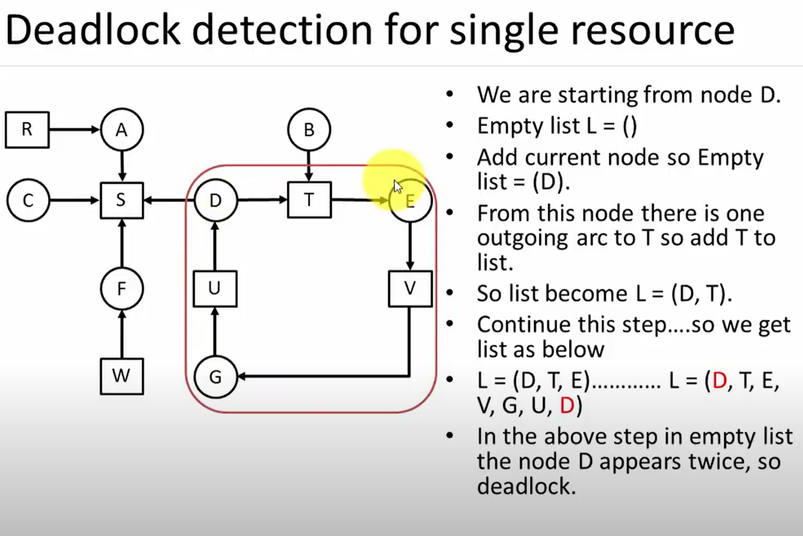

Slide 9
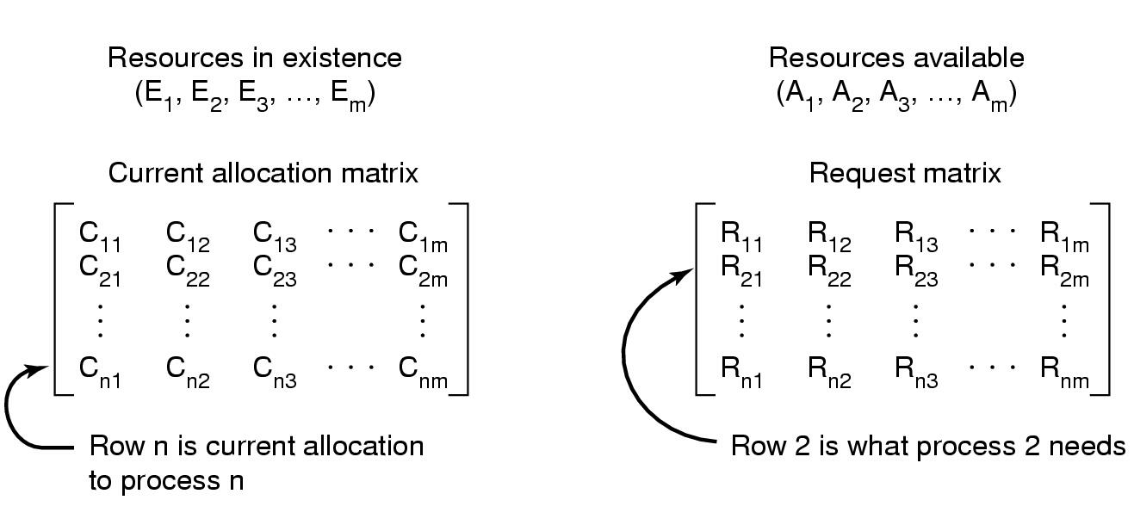
Detection with Multiple Resources of Each Type
Data structures needed by deadlock detection algorithm

Slide 10
Detection with Multiple Resources of Each Type
Every resource is allocated or available

Slide 11
Detection with Multiple Resources of Each Type
Let n = number of processes and m = number of resource types.
Available: Vector of length m. If Available[j] = k, there are k instances of resource type R_{j} available.
Allocation: n x m matrix. If Allocation[i, j] = k, then P_{i} is currently allocated k instances of R_{j}.
Request: n x m matrix. If Request[i, j] = k, then P_{i} is requesting k instances of resource type R_{j}.

Slide 12
Detection Algorithm (Short Form)
Look for unmarked process P_{i} for which the i-th row of R is less than or equal to A
If such a process is found, add the i-th row of C to A, mark the process, go to step 1
If no such process exists, terminate

Slide 13
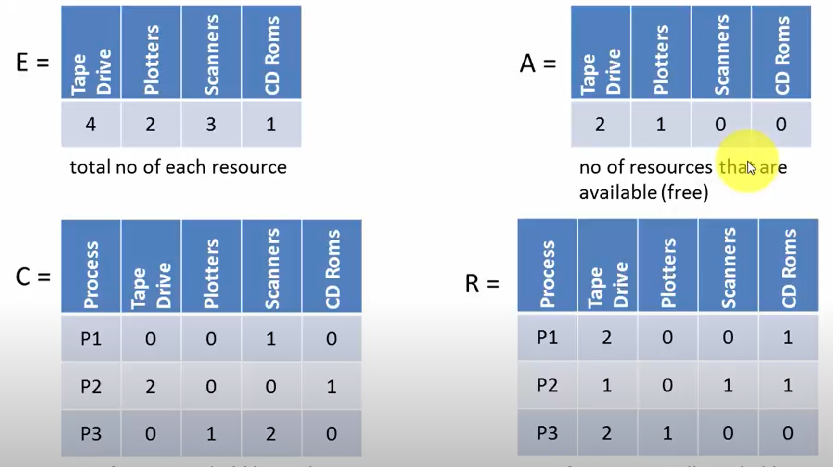
Example

Slide 14
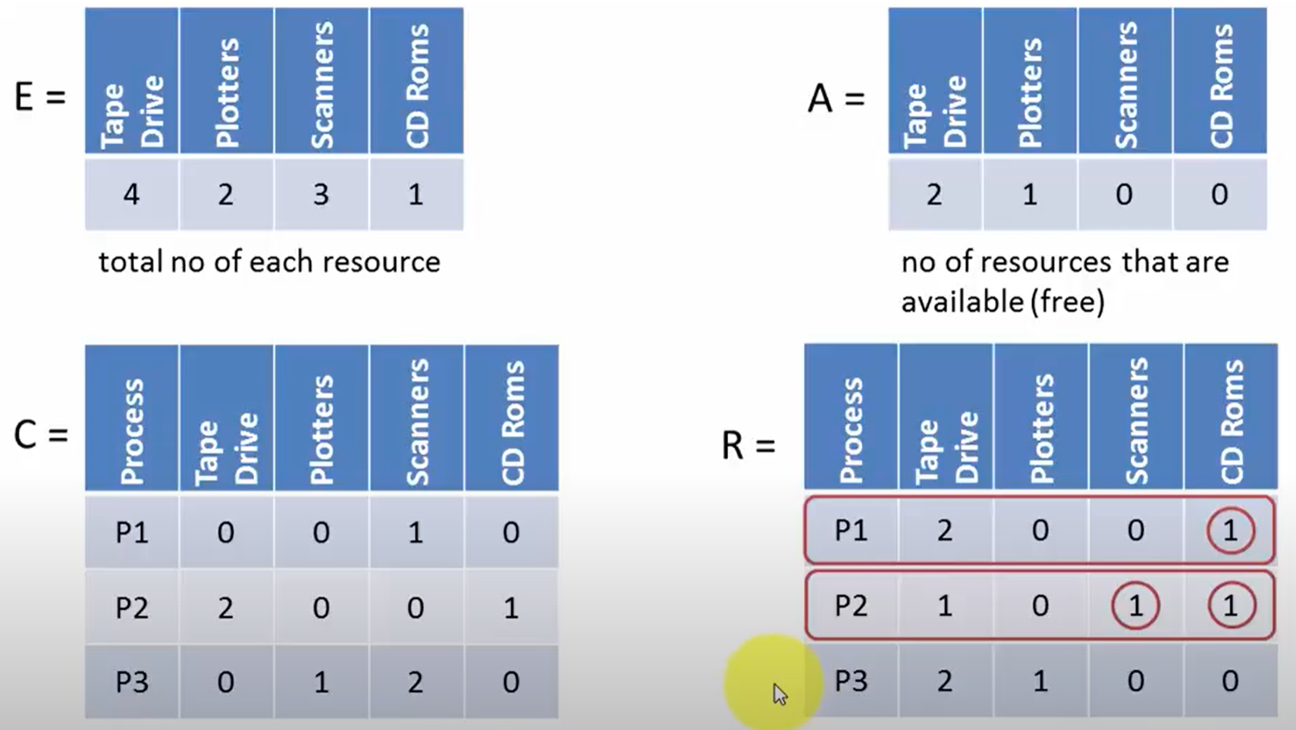
Example

Slide 15
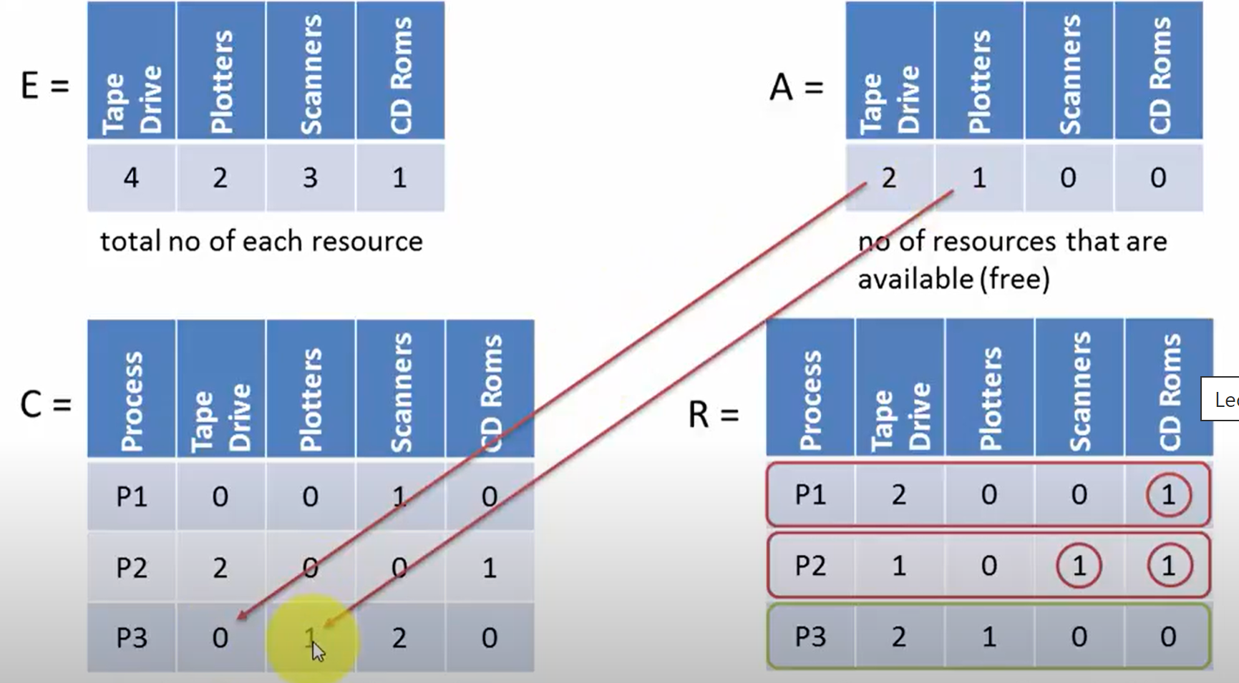
Example

Slide 16
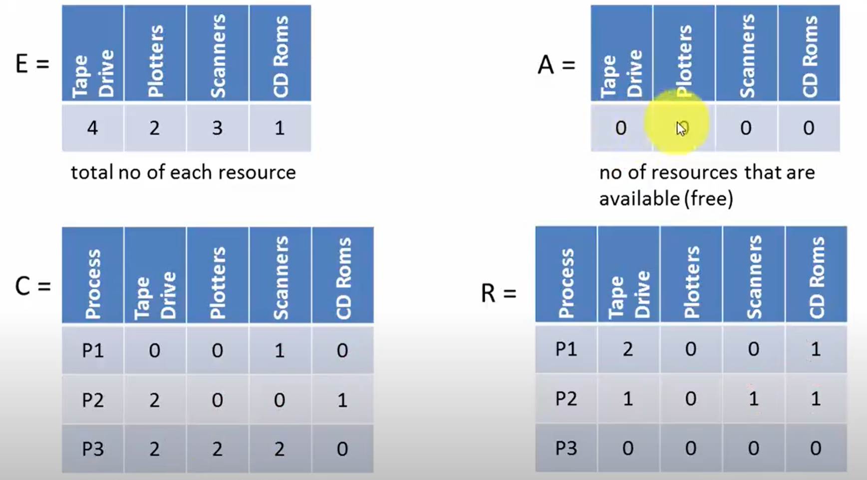
Example

Slide 17
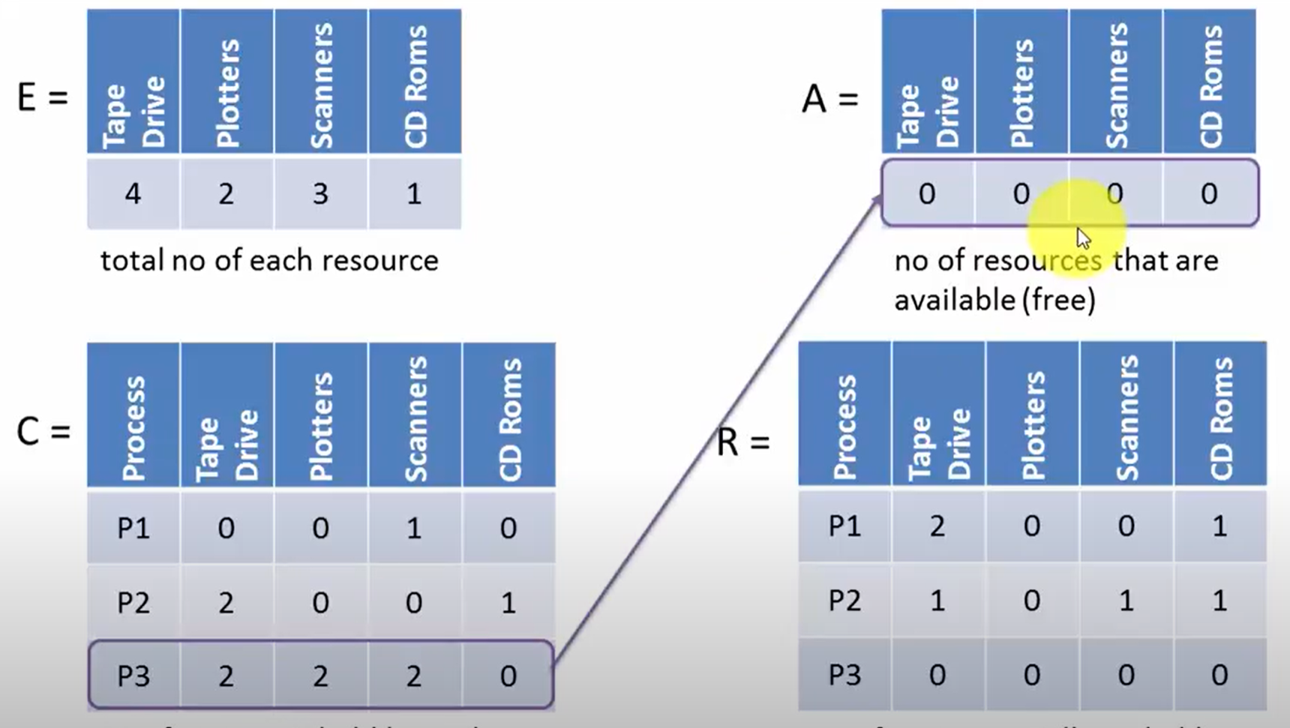
Example

Slide 18
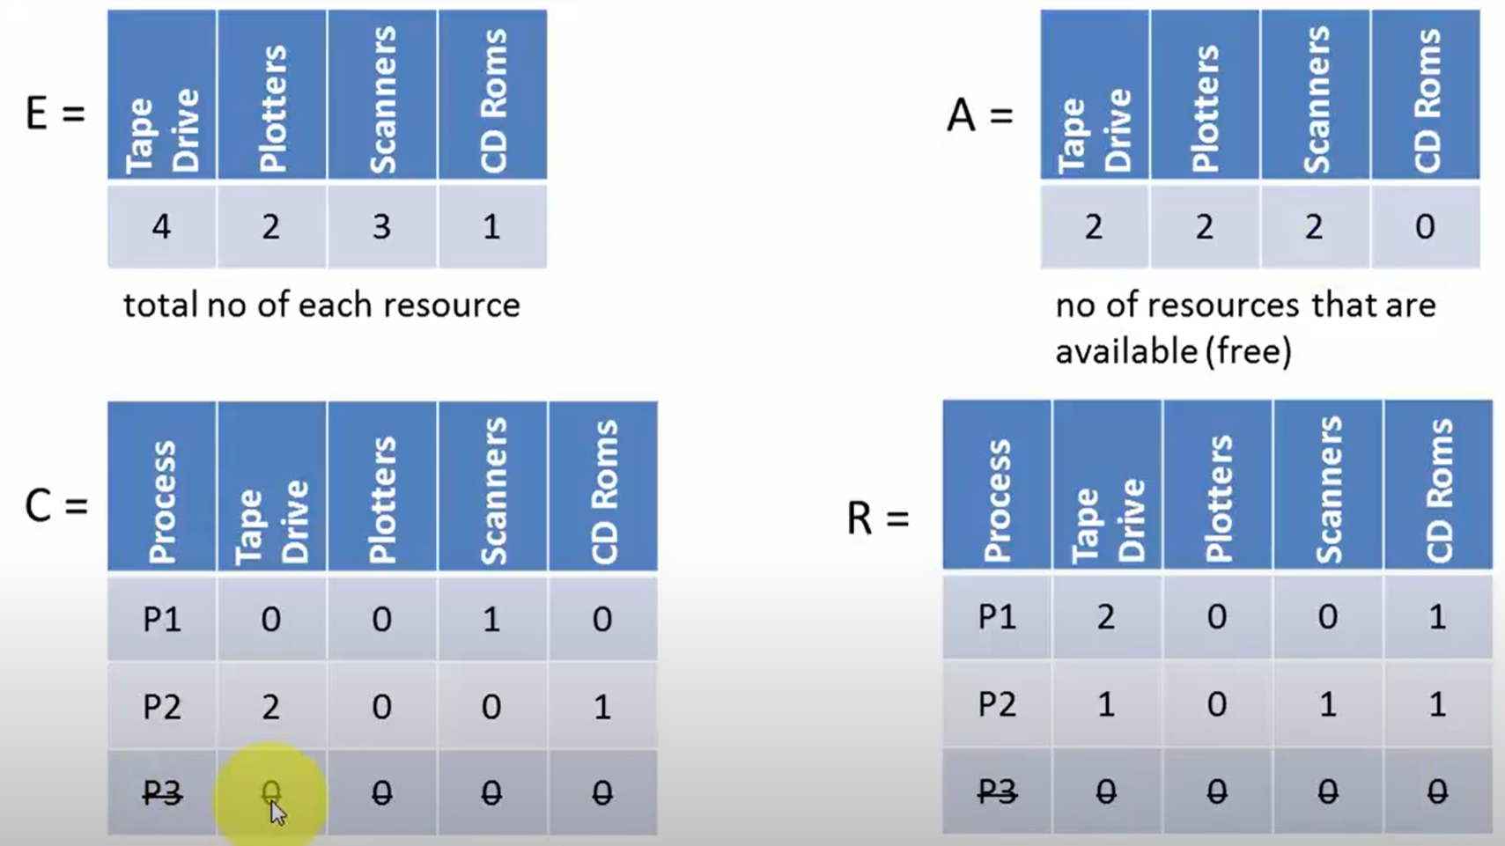
Example

Slide 19

Example

Slide 20
Example (2)
Solution??

Slide 21
Recovery from Deadlock
Recovery through preemption
take a resource from some other process
depends on nature of the resource
Recovery through rollback
checkpoint a process periodically (Checkpointing a process means that its state is written to a file so that it can be restarted later. The checkpoint contains not only the memory image, but also the resource state, in other words, which resources are currently assigned to the process)
use this saved state
restart the process if it is found deadlocked

Slide 22
Recovery from Deadlock
Recovery through killing processes
crudest but simplest way to break a deadlock
kill one of the processes in the deadlock cycle
the other processes get its resources
choose process that can be rerun from the beginning

